Slide 1
Starry Sky Animation Quiz
Dr Nitin Paranjape
For details, read this blog post
http://efficiency365.wordpress.com

Slide 2
Instructions
Read instructions and click
Next slide runs automatically
Observe the animation for at least 30 seconds.
The entire animation cycle is for 2 minutes but you need not see the entire animation
Then stop the presentation
Analyze and learn how the 3rd slide was created
Post the steps of creating this slide as comments below the post

Slide 3
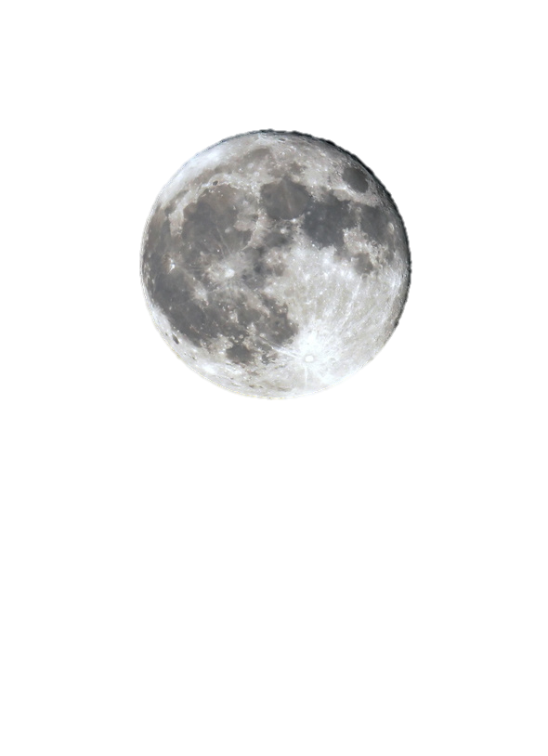

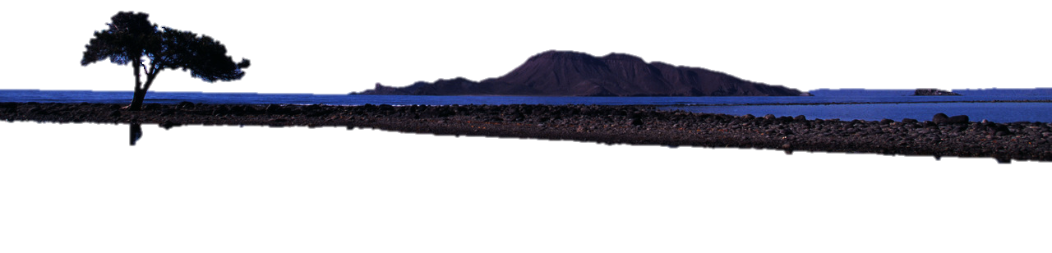
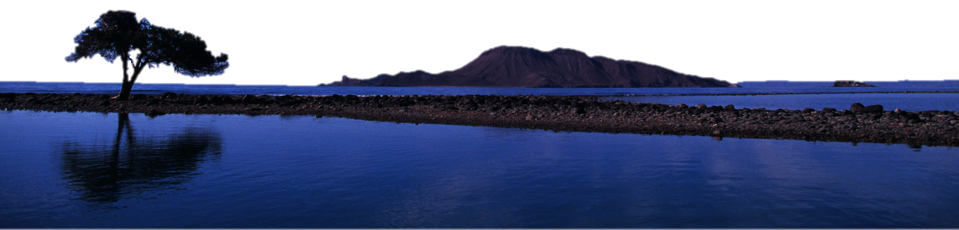
Dr Nitin Paranjape

Slide 4

Post your answer as a comment for this blog post
This post contains detailed instructions

