Slide 1

Instant Transparency to be used with this article

Slide 2
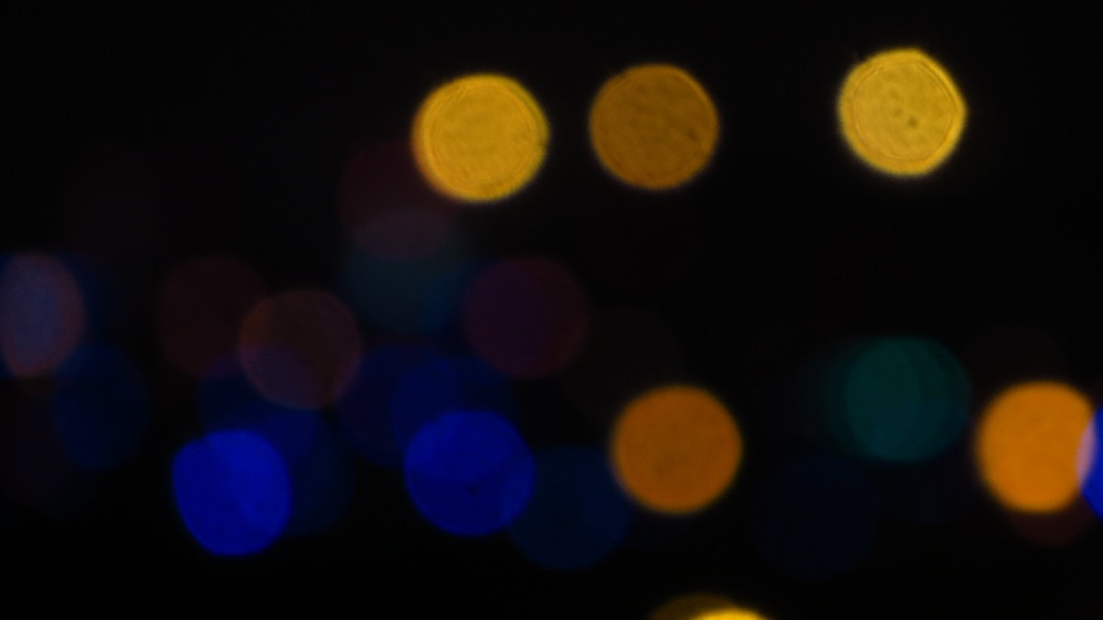
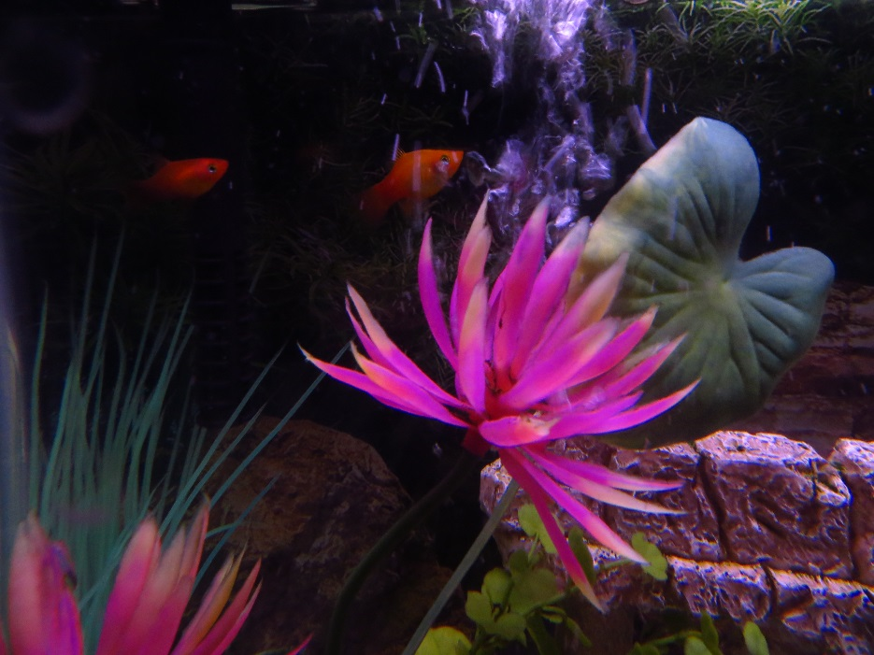
Two images.
We want to mix them.

Slide 3


Resize one of the images and capture the mixed version

