Slide 1

Transparency Demo To be used with the blog post How to make Pictures and Videos Transparent
Dr Nitin Paranjape
http://Efficiency365.wordpress.com

Slide 2

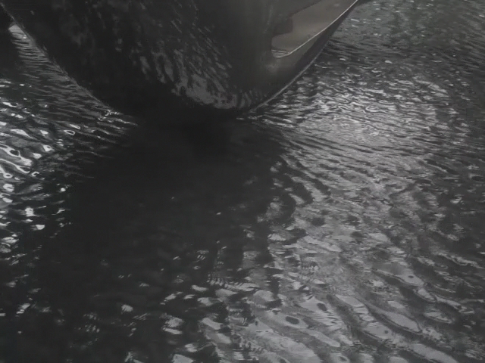
Work Smart Grow Fast

Slide 3
Details
Video is compressed to reduce file size
The video repeats after it finishes (5 sec)
Clouds are not a video. It is a picture.
It is sized much bigger than the slide
Clouds move using line path motion
Clouds have transparency applied
Brightness / contrast of video has been tweaked to create sharper visual impact

