Slide 1
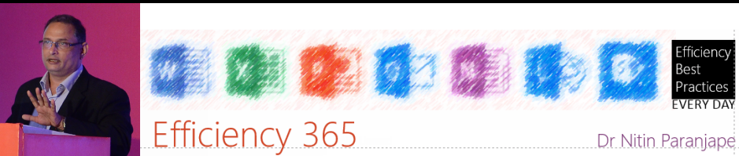
Bounce End to be used with this article
There is no narration or music. Just read and move on.

Slide 2
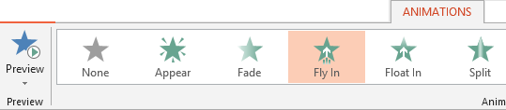
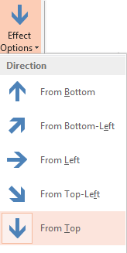
Animation to make the ball fall
To make the ball drop from top
Use Entry animation Fly In (from Top)
Effect Option – From Top
Click to see the effect

Slide 3
Fly in works like this…
The animation worked
But it stopped in an abrupt manner

Slide 4
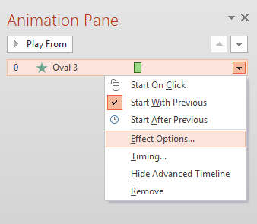
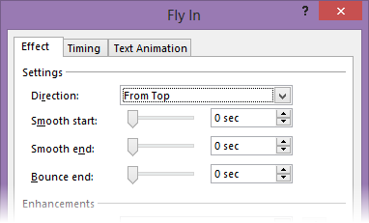
How did this animation happen?
Animation Pane shows the details

Slide 5
Effect Options for movement
Smooth start and Smooth end control the acceleration and deceleration of the movement
at the beginning and ending point
Bounce End makes the ending movement oscillate
In this case all values are zero

Slide 6
Changing Bounce End setting
We want to focus
on the Bounce
End option
I am going to
increase it to
0.4 seconds
Now let us run the
animation and see
the impact.

Slide 7
This is bounce end animation
The left side is without Bounce
The right side is with Bounce
Click to see the effect

Slide 8
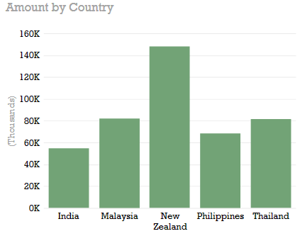
Bounce looks more natural
Here is an Excel image
Same Fly-In Effect with .4 sec bounce
Click to see the effect

Slide 9
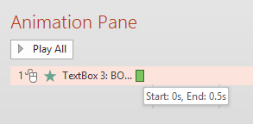

How does it work?
Total duration for the effect is 0.5 sec
That is the time available for an object to come in from outside the slide and stop at the final position
Usually it takes all the available time to do this action
But when you say 0.4 sec is for bounce, it has to traverse the same distance in 0.1 sec
Therefore it comes in fast and bounces for the remaining 0.4 sec
BOUNCE
Click to see the effect

Slide 10
Want it to bounce longer?
Increase overall duration and the bounce duration
Click to see the effect

Slide 11
Which animations have bounce option?
All motion paths
Most entry animations
which involve movement
Exit animations DO NOT have this option because there is nothing to see at the end!
Zoom In Entry animation does not have this option.
But GROW / SHRINK Emphasis animation has it
Very beautiful to look at.
Click to see the effect

Slide 12
Spin Emphasis animation also looks beautiful with bounce
Duration 2 sec. All animations are repeating
Click to see the effect
Bounce 2 sec
Bounce 1 sec
Bounce 1.6 sec

Slide 13
Usage Best Practices
Just because it is nice, do not overuse it
Use it where it makes a difference
Don’t use excessive bounce duration
Make sure it does not distract from the main topic
Experiment with it with different objects
Remember that all animations can be applied to videos as well – so does Bounce End option

Slide 14
Thank you
Post feedback about this article
Share this with your friends and colleagues
Follow my blog Efficiency 365
Follow me on Twitter @drnitinp

