Slide 1

Displaying images professionally
To be used with this blog article
Click to view next slide

Slide 2

Click to view the next slide

Slide 3

Click to view the next slide

Slide 4
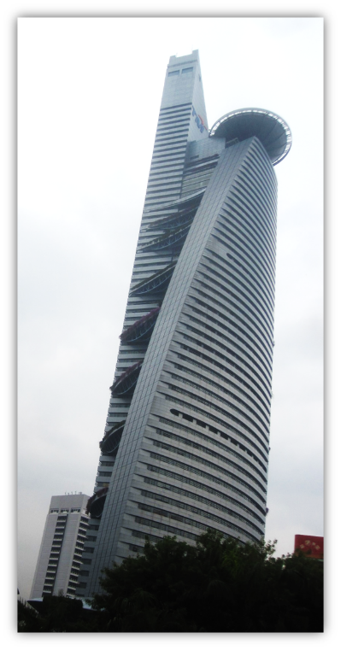
Click to view the next slide

