Slide 1
Concept to Reality
Artistic Effect + Animation + Remove Background
Dr Nitin Paranjape
http://efficiency365.com

Slide 2

Base Picture

Slide 3

Two pictures

Slide 4
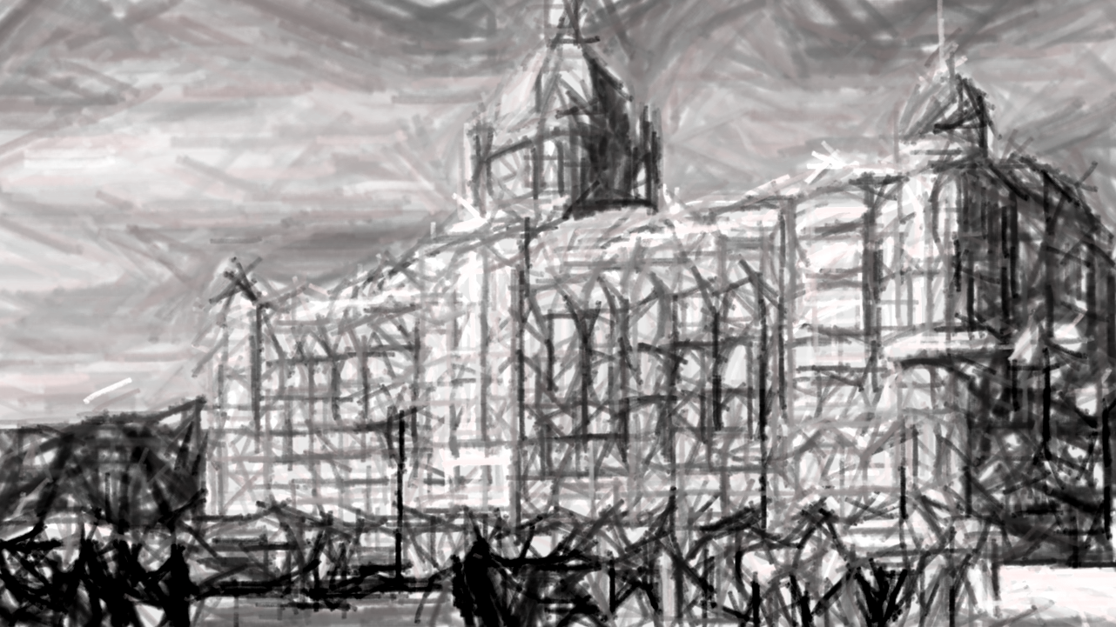
Artistic effect applied

Slide 5
Both overlapping
Fade Effect
(click to view effect)

Slide 6
Wipe from Bottom
(click to view effect)

Slide 7
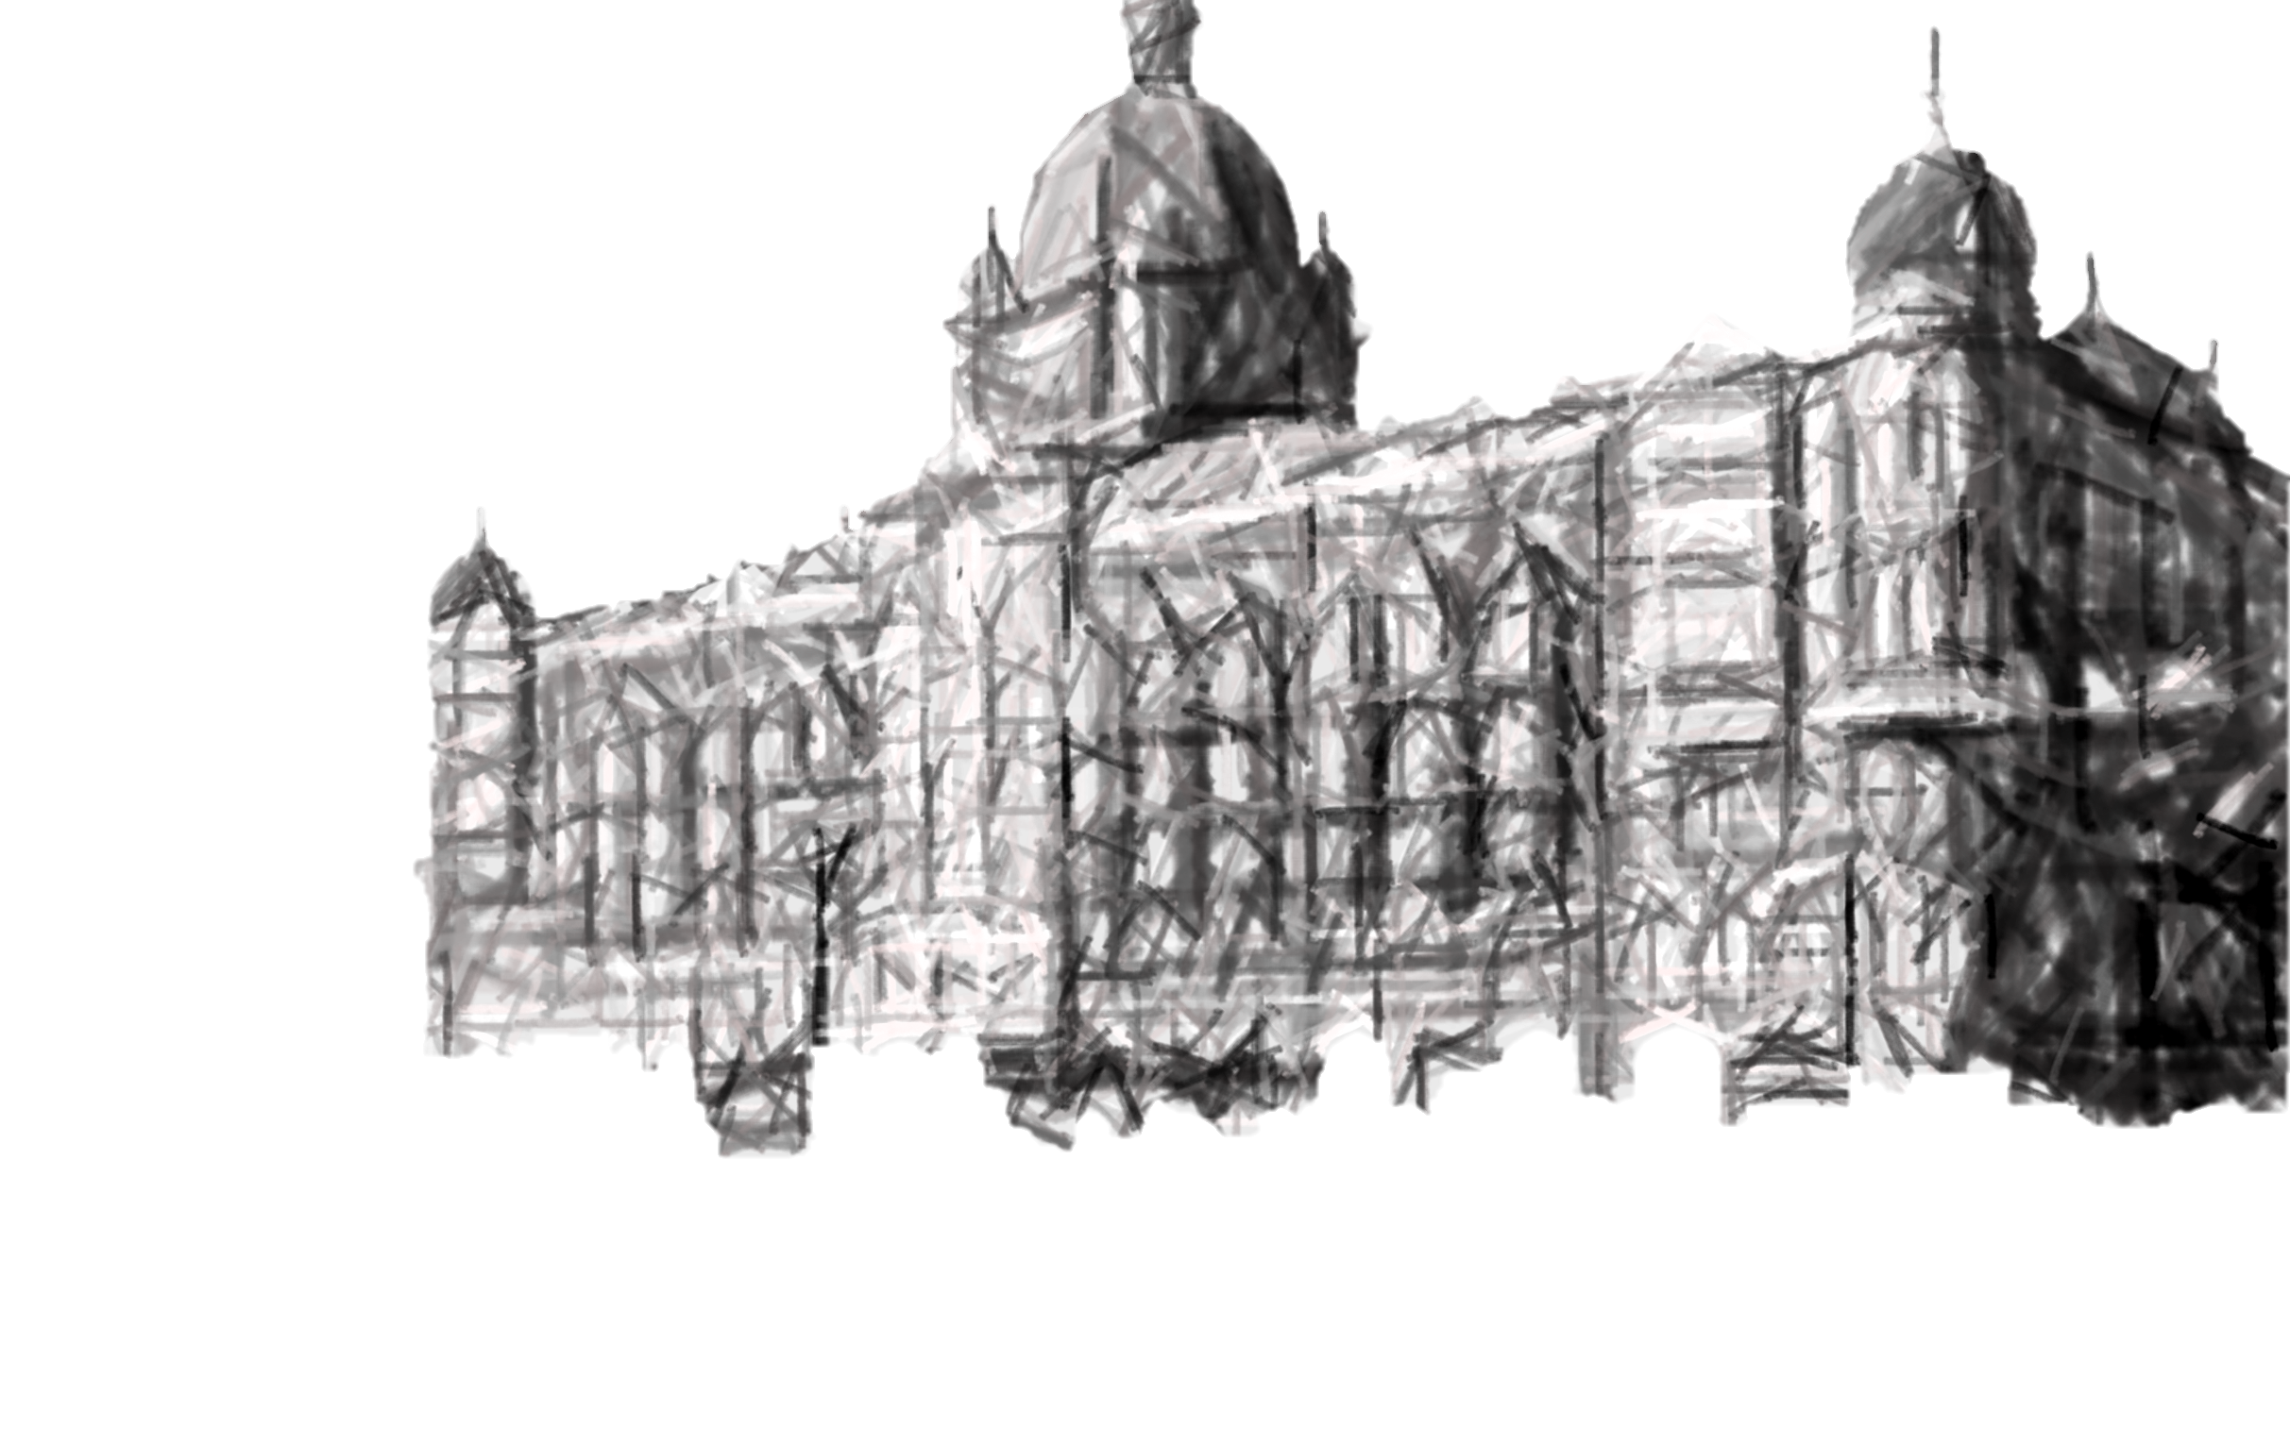

Using Remove Background
(click to view effect)
Three layers
Base – whole picture
Middle – Only building with artistic effect and Fade Animation
Top – Only building

