Slide 1
Happy Dussehra
by Dr Nitin Paranjape

Slide 2
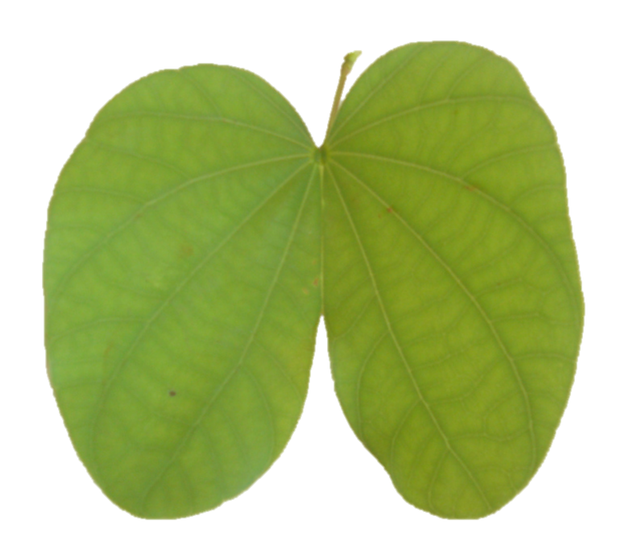
Notes:
Base Image – Remove Background.

Slide 3
Happy
Dusserha
Notes:
Added text. Select Leaf first and then the text. Choose Drawing tools – Merge Shapes – Subtract.

Slide 4
Notes:
Subtract keeps the text with part of the image inside it. Now it is no longer text. It is an image.

Slide 5
Notes:
Variation 1: Use the text image with black inner shadow.

Slide 6
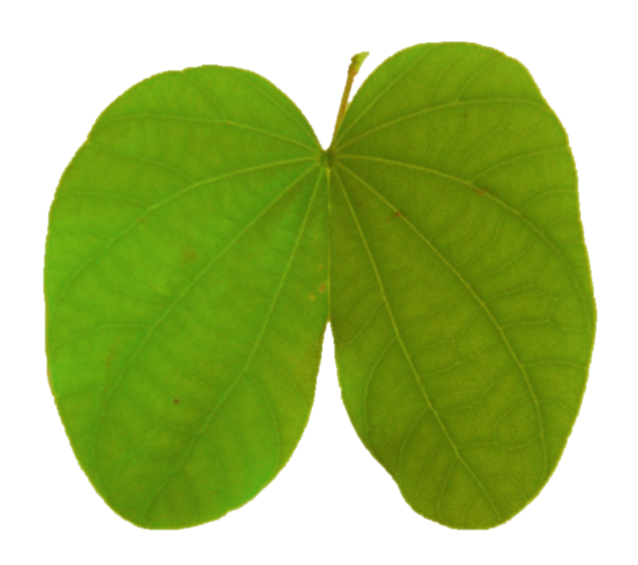
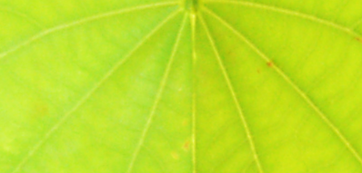
Notes:
Variation 2: Change Brightness, Contrast, Sharpness. Notice that the structure of the leaf continues visually through the text – which makes it look very natural.

Slide 7
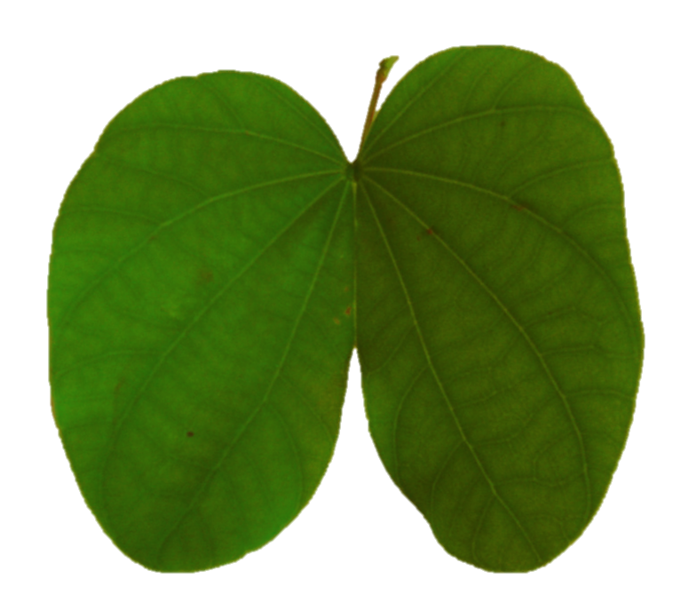
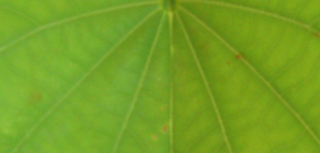
Notes:
Used a rectangle with a gradient. Colors of the gradient picked up from the leaf itself. Why rectangle? Why not use the same gradient in slide background itself? Because for radial gradient starting from the center, the exact center becomes the physical center of the slide. With a rectangle, the position of the visual center of the gradient can be changed by moving the rectangle. Little shadow for the text and the leaf.
That’s it.

