Slide 2
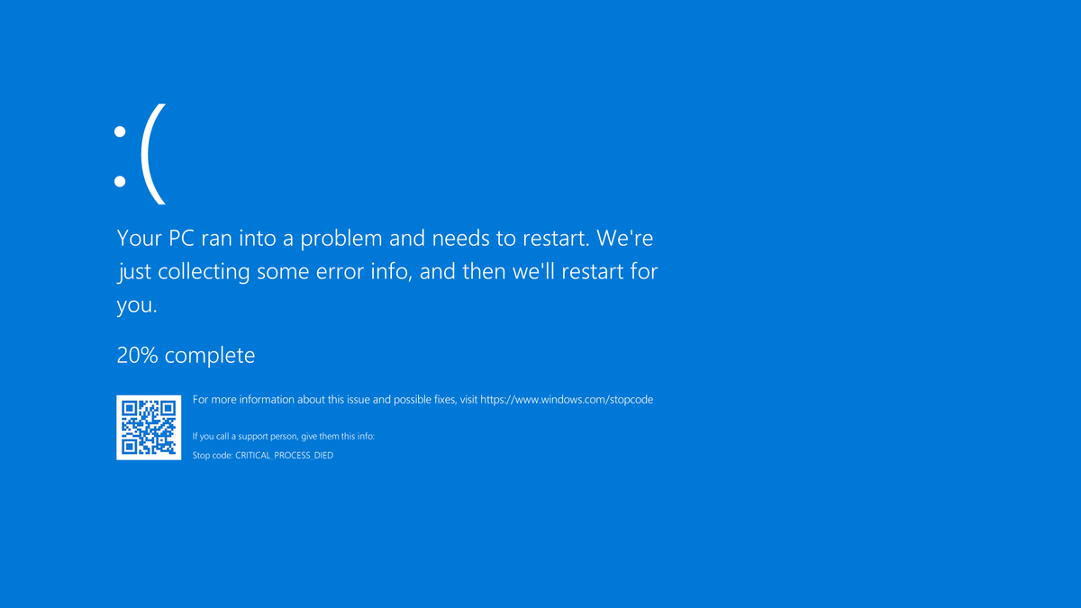
30%
50%
90%

Slide 3


Slide 5
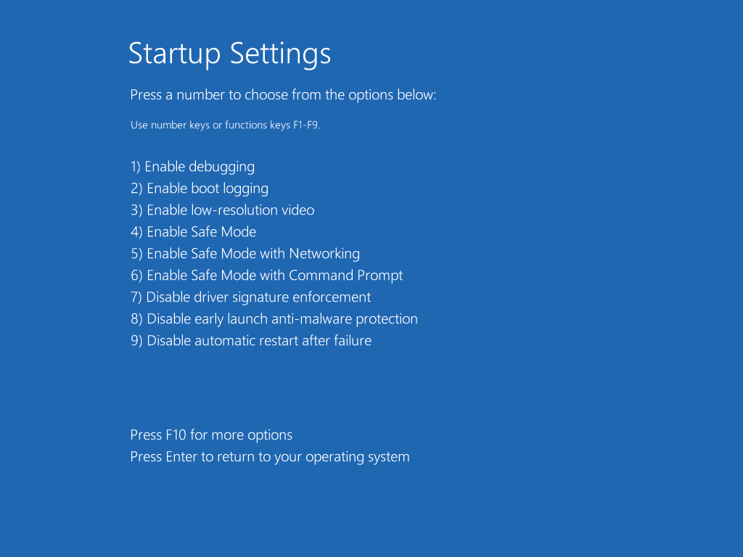

Slide 9
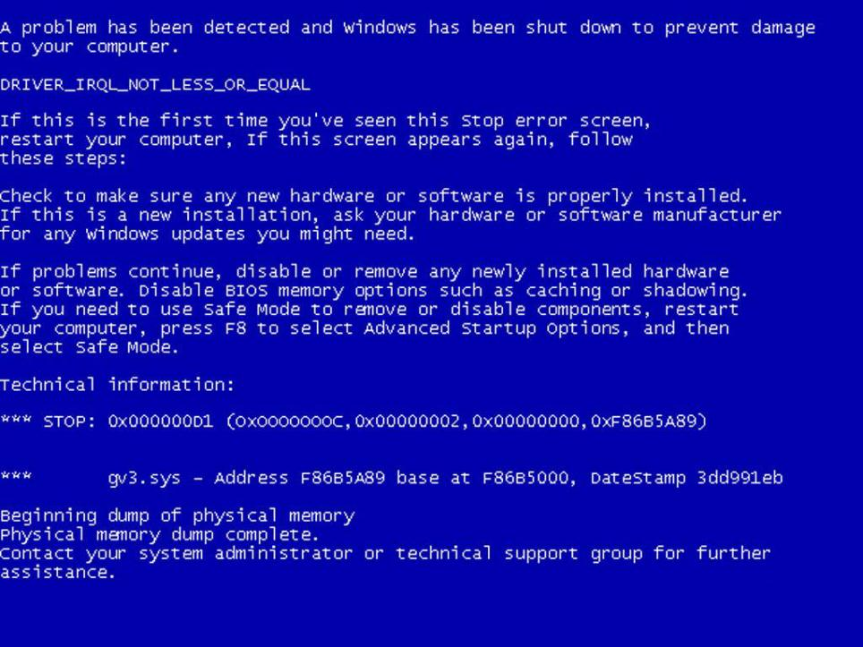

Slide 10


MX G061 Series
BIOS Revision A09

Slide 11
